Slide 1

PROJECT REPORT “FARMERLY”
SUBMITTED BY :
NAME – Manjunath Hegde
BRANCH – Electronics and Communication

Slide 2
AGENDA
Introduction
Goals & Objectives
Data Preprocessing
Data Visualization
Machine Learning Models
Model Selection
Future Scope & Improvisation

Slide 3
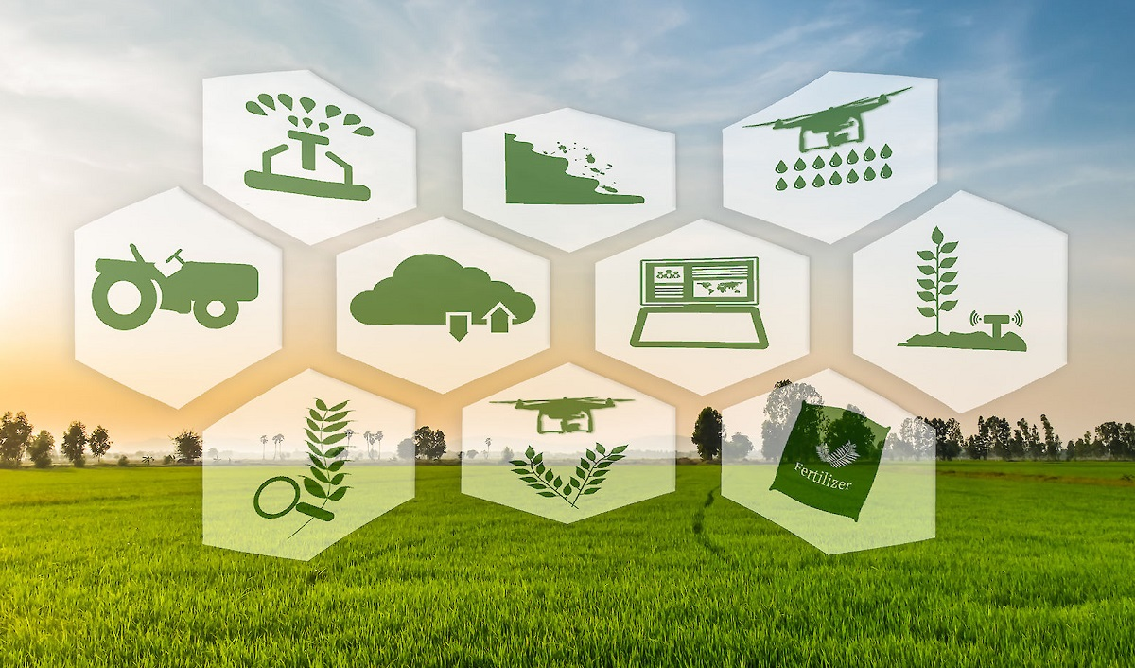
INTRODUCTION
Welcome to a digital journey where the age-old art of farming meets the precision of data science.
In a world striving for "Zero Hunger" and sustainable economic growth, our project, aptly named “FARMERLY” takes center stage.
Picture a symphony where every data point dances in harmony with the soil, nurturing the growth of crops and fostering a future where agriculture meets the algorithms.

Slide 4
GOALS & OBJECTIVES
Our mission stands tall in harmony with the UN Sustainable Development Goals - specifically, "Zero Hunger" and "Promote sustained, inclusive, and sustainable economic growth."
These goals find expression in Smart Farming Tips, where technology predicts the best crops for farmers, providing a roadmap for harvests.
Technology for Farmers utilizes predictive analysis along with weather apps, ensuring that our agricultural practices are as informed as they are innovative.
By offering Financial Help for Farmers, we empower them to invest in their farms, creating a ripple effect of prosperity.
Our holistic approach combines farming insights with financial support, contributing to a world where each harvest symbolizes progress toward a sustainable and hunger-free future.

Slide 5
DATA PREPROCESSING
Libraries Used: Numpy, Pandas, Seaborn, Matplotlib, Scikit-learn
Data Import: Utilized Pandas to import and structure the Farmerly dataset.
Data Cleaning: Addressed missing data using SimpleImputer to fill NaN values with the mean.
Exploratory Data Analysis: Descriptive statistics provided insights into the dataset's central tendencies.

Slide 6
DATA VISUALIZATION
Insights from Visualizations: Heatmap revealed patterns of missing values.
Temperature and pH distributions showcased the dataset's variability.
Countplot and pairplot visually represented crop distribution and feature relationships.
Jointplots illustrated correlations between humidity, potassium levels, and rainfall.

Slide 7
MACHINE LEARNING MODELS
Models Used: Logistic Regression, SVM, K-Nearest Neighbours, Decision Tree, Random Forest, Bagging, AdaBoost, Gradient Boosting, Extra Trees.
Accuracy Scores:
Logistic Regression: 96.36%
SVM: 96.82%
K-Nearest Neighbours: 95.91%
Decision Tree: 98.41%
Random Forest: 99.32%
Bagging: 99.09%
AdaBoost: 14.09%
Gradient Boosting: 98.18%
Extra Trees: 90.68%

Slide 8
MODEL SELECTION
Model of Choice: Random Forest
Accuracy Achieved: 99.32%
Why Random Forest?
Ensemble Power:
Random Forest is an ensemble learning method that builds a multitude of decision trees during training.
Each tree in the forest operates independently, and the final prediction is based on the majority vote or average prediction.
Robustness and Accuracy:
The ensemble nature helps mitigate overfitting by combining the strength of multiple trees, reducing the risk of a single tree making an erroneous prediction.
3. Minimizing Overfitting:
Random Forest introduces randomness during the tree-building process, such as using random subsets of features for each tree and random data sampling, Hence minimizes overfitting.

Slide 9
FUTURE SCOPE & IMPROVISATION
Website Integration:
Future Integration: Develop a user-friendly website for farmers to access real-time insights, personalized recommendations, and a user interface for data input.
Benefits: Enhance accessibility, usability, and outreach to a wider farming community.
Database Implementation:
Future Enhancement: Establish a robust database system to store and manage vast agricultural data efficiently.
Advantages: Improved scalability, streamlined data retrieval, and support for more comprehensive analytics.
3. Continuous Model Refinement:
Improvement Strategy: Regularly update and refine machine learning models based on ongoing data collection and technological advancements.
Benefits: Stay at the forefront of predictive analytics, ensuring accurate and up-to-date crop predictions.

Slide 10
THANK YOU

